Slide 1
Programmable Logic
PAL, PLA

Slide 2
PLAs
Programmable Logic Array
  Pre-fabricated building block of many AND/OR gates (or NOR, NAND) "Personalized" by making/ breaking connections among the gates.
  General purpose logic building blocks.

Slide 3
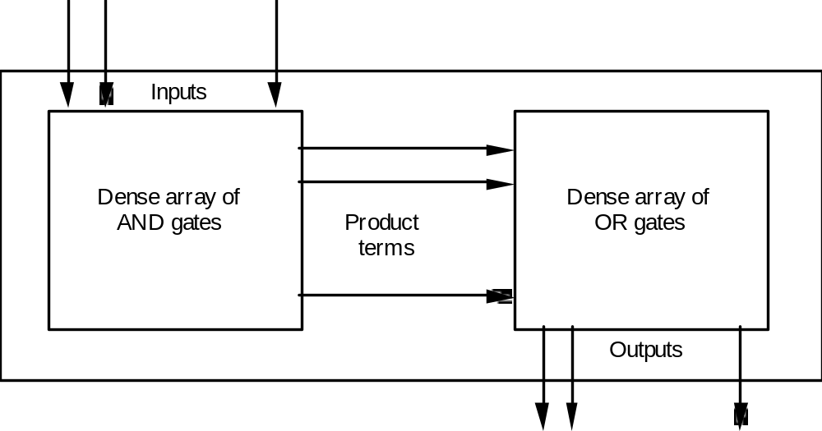
PLA

Slide 4
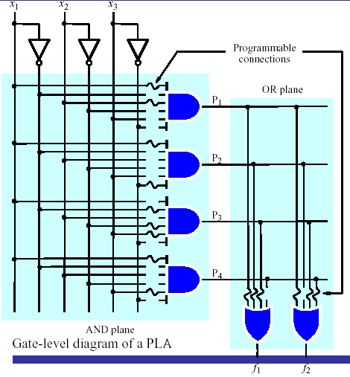
PLA

Slide 5
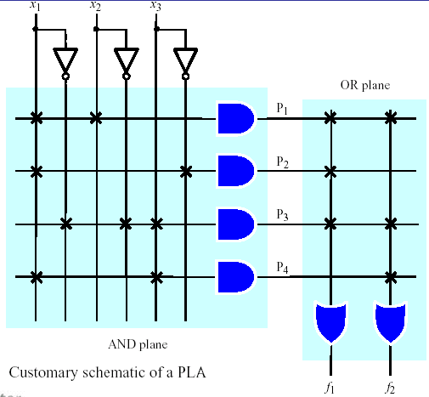
PLA
A 3×2 PLA with 4 product terms.

Slide 6
Design for PLA:
Example
  Implement the following functions using PLA
F0 = A + B' C'
F1 = A C' + A B
F2 = B' C' + A B
F3 = B' C + A
Input Side:
1 = asserted in term
0 = negated in term
- = does not participate
Personality Matrix
Product
Inputs
Outputs
t
Output Side:
erm
A
B
C
F
F
F
F
0
1
2
3
1 = term connected to output
0 = no connection to output
A B
1
1
-
0
1
1
0
B C
-
0
1
0
0
0
1
Reuse
A C
1
-
0
0
1
0
0
of
t
1
0
1
0
erms
B C
-
0
0
A
1
-
-
1
0
0
1

Slide 7
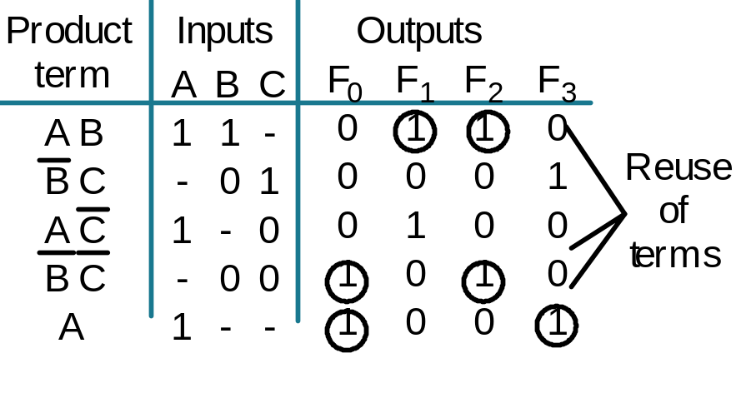

Example: Continued
A
B
C
F0 = A + B' C'
F1 = A C' + A B
F2 = B' C' + A B
F3 = B' C + A
AB
B’C
AC’
B’C’
Personality Matrix
A
F0
F1
F2
F3

Slide 8
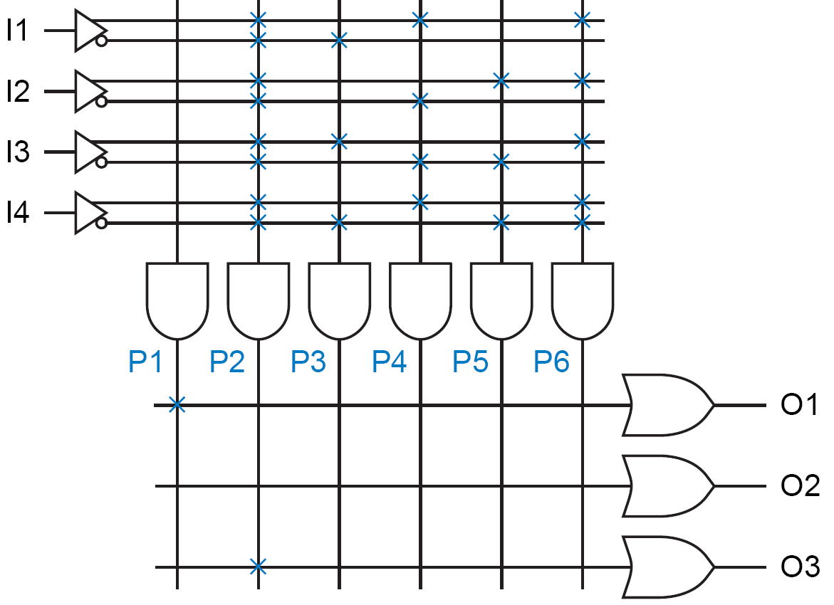
Constants
  Sometimes a PLA output must be programmed to be a constant 1 or a constant 0.
    P1 is always 1 because its product line is connected to no inputs and is therefore always pulled HIGH;
    this constant-1 term drives the O1 output.
  No product term drives the O2 output, which is therefore always 0.
  Another method of obtaining a constant-0 output is shown for O3.

Slide 9
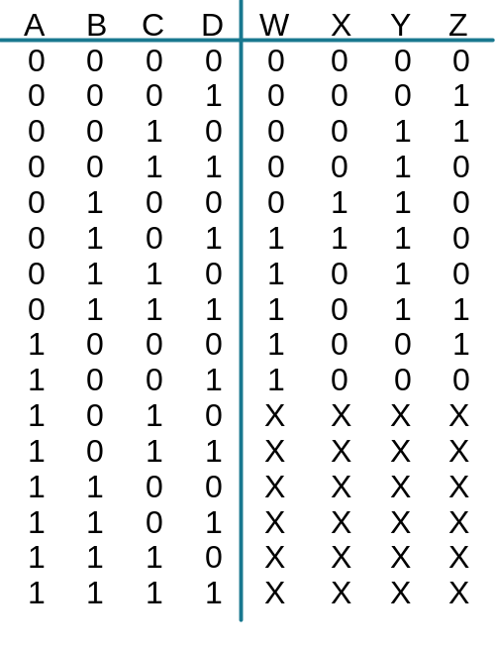
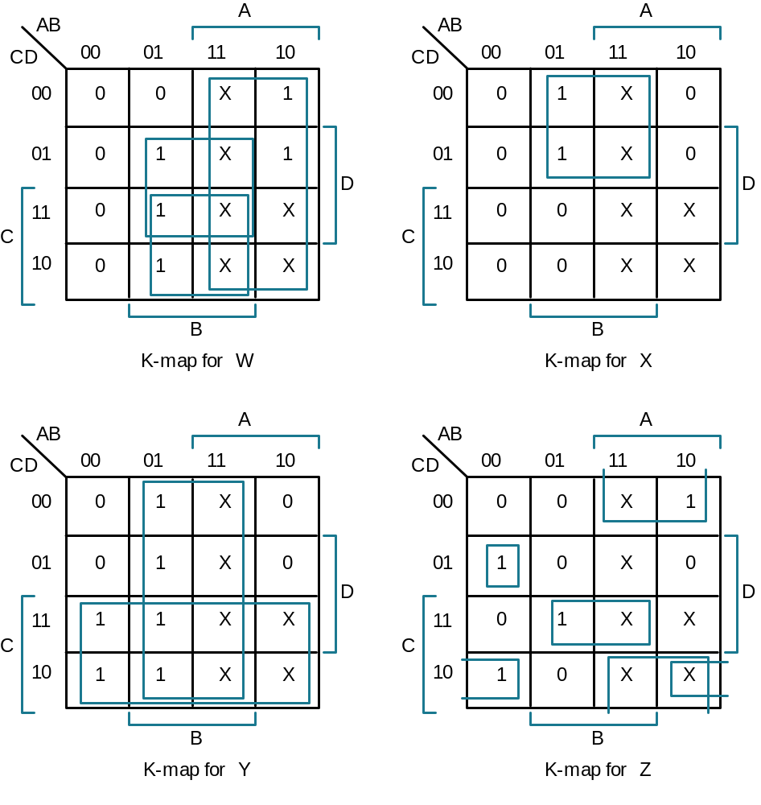
BCD to Gray Code Converter
Minimized Functions:
W = A + B D + B C
X = B C'
Y = B + C
Z = A'B'C'D + B C D + A D' + B' C D'

Slide 10
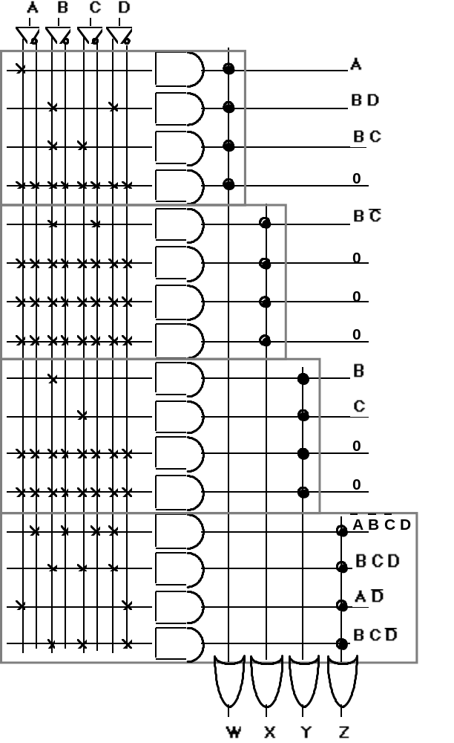
A B C D
A
BD
4 product terms per each OR gate
BC
BC’
Product terms cannot be shared !
B
PLA achieves higher flexibility at the cost of lower speed!
C
BCD
AD’
BCD’
W X Y Z

Slide 11
PALs
Programmable Array Logic
  a fixed OR array.

Slide 12
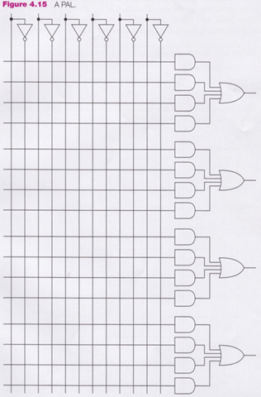
PAL
inputs
1st output
section
2nd output
section
Only functions with
at most four
products can be
implemented
3rd output
section
4th output
section

Slide 13
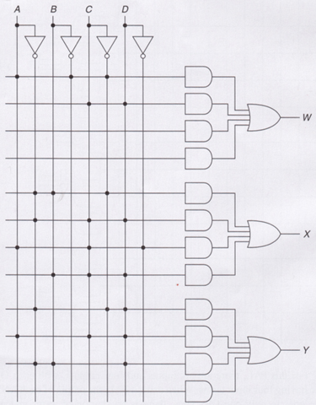
PAL
x
x
x
W = AB′C′ + CD
X = A′BC′ + A′CD + ACD′ + BCD
Y = A′C′D + ACD + A′BD

Slide 14
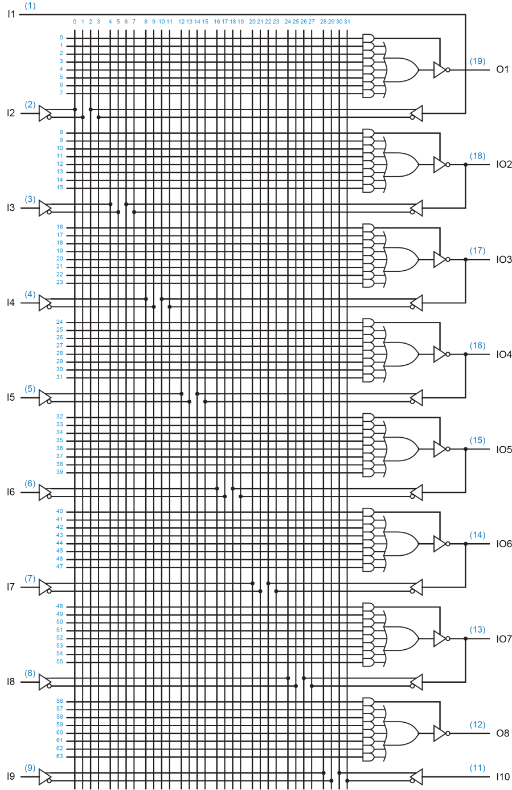
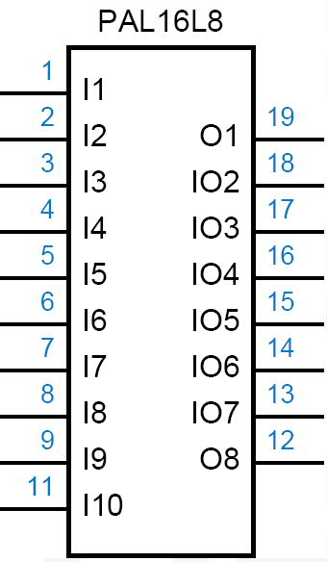

Slide 15

Helper Terms
  If an I/O pin’s output-control gate produces a constant 1, → the output is always enabled, but the pin may still be used as an input too.
  → outputs can be used to generate first-pass “helper terms” for logic functions that cannot be performed in a single pass with the limited number of AND terms available for a single output.

Slide 16
Read-Only Memory
ROM

Slide 17

ROM
Decoder
  Produces minterms
ORs
  Produce SOP’s
0
A
‘B’C’D’
1
A
‘B’C’D
F
2
A
‘B’CD’
1
3
A
‘B’CD
A
S₃
4
A
‘BC’D’
S₂
5
A
‘BC’D
B
6
A
‘BCD’
4:16
7
A
‘ BCD
C
S₁
dec
8
A
B’C’D’
F
9
A
B’C’D
2
D
S₀
10
A
B’CD’
1
1
A
B’CD
12
A
B C’D’
13
A
B C’D
14
A
B C D’
F
15
A
B C D
3
Enb

Slide 18
ROM
ROM
  A decoder
  A set of programmable OR’s
D7
X
X
X
D6
D5
X
X
D4
X
A
A2
D3
X
D2
X
X
B
A1
D1
A0
D0
X
C
F3
F2
F1
F0

Slide 19
ROM vs. PLA/PAL
Fixed
Programmable
Programmable
Inputs
AND array
Connections
OR array
Outputs
(decoder)
(a) Programmable read-only memory (PROM)
Inputs
Programmable
Programmable
Fixed
Connections
AND array
OR array
Outputs
(b) Programmable array logic (PAL) device
Programmable
Programmable
Programmable
Programmable
Inputs
Connections
AND array
Connections
OR array
Outputs
(c) Programmable logic array (PLA) device

Slide 20
General Logic Implementation
  Given a 2^{k}xn ROM, we can implement ANY combinational circuit with at most k inputs and at most n outputs.
Why?
  k-to-2^{k} decoder will generate all 2^{k} possible minterms
  Each of the OR gates must implement a ∑m()
  Each ∑m() can be programmed

Slide 21
Example
Find a ROM-based circuit implementation for:
  f(a,b,c) = a’b’ + abc
  g(a,b,c) = a’b’c’ + ab + bc
  h(a,b,c) = a’b’ + c
Solution:
  Express f(), g(), and h() in ∑m() format (use truth tables)
  Program the ROM based on the 3 ∑m()’s

Slide 22
Example
  There are 3 inputs and 3 outputs, thus we need a 8x3 ROM block.
    f = ∑m(0, 1, 7)
    g = ∑m(0, 3, 6, 7)
    h = ∑m(0, 1, 3, 5, 7)
a
0
1
2
3
4
5
6
7
b
3-to-8
decoder
c
f
g
h

Slide 23
ROM as a Memory
Read Only Memories (ROM) or Programmable Read Only Memories (PROM) have:
  N input lines,
  M output lines, and
  2^{N} decoded minterms.
Can be viewed as a memory with the inputs as addresses of data (output values),
  hence ROM or PROM names!

Slide 24
(Memories)
Volatile:
  Random Access Memory (RAM):
    SRAM "static"
    DRAM "dynamic"
Non-Volatile:
  Read Only Memory (ROM):
    Mask ROM "mask programmable"
    EPROM "electrically programmable"
    EEPROM “electrically erasable electrically programmable"
    FLASH memory - similar to EEPROM with programmer integrated on chip

Slide 25
ROM as Memory
Read Example: For input (A₂,A₁,A₀) = 011, output is (F₀,F₁,F₂,F₃ ) = 0010.
What are functions F₃, F₂ , F₁ and F₀ in terms of (A₂, A₁, A₀)?
Address
8x4 ROM
D0
X
X
X
0 | 1 | 1 | 0 | 1
1 | 0 | 0 | 0 | 0
2 | 1 | 0 | 0 | 1
3 | 0 | 0 | 1 | 0
4 | 0 | 0 | 0 | 0
5 | 1 | 0 | 0 | 0
6 | 0 | 0 | 1 | 1
7 | 0 | 1 | 0 | 0
D1
D2
X
X
D3
X
A
A2
D4
X
A[2:0]
F[3:0]
D5
X
X
B
A1
D6
3
4
A0
D7
X
C
F0
F1
F2
F3

Slide 26
Design by ROM: Example
BCD to 7 Segment Display Controller
A B C D
C0 C1 C2 C3 C4 C5 C6
0 0 0 0
0 0 0 1
0 0 1 0
0 0 1 1
0 1 0 0
0 1 0 1
0 1 1 0
0 1 1 1
1 1 1 1 1 1 0
0 1 1 0 0 0 0
1 1 0 1 1 0 1
1 1 1 1 0 0 1
0 1 1 0 0 1 1
1 0 1 1 0 1 1
1 0 1 1 1 1 1
1 1 1 0 0 0 0
1 1 1 1 1 1 1
1 1 1 0 0 1 1
1 0 0 0
1 0 0 1
1 0 1 0
1 0 1 1
1 1 0 0
1 1 0 1
1 1 1 0
0 1 1 1
X X X X X X X
X X X X X X X
X X X X X X X
X X X X X X X
X X X X X X X
X X X X X X X

Slide 27
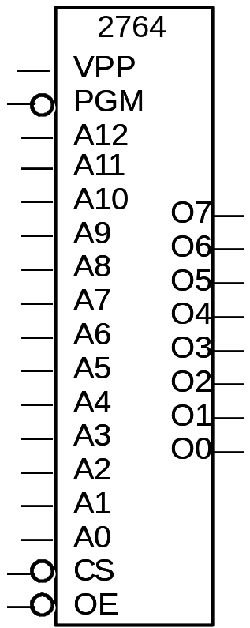
Standard Devices
  Vpp and PGM are used when programming
2764 EPROM
8K x 8

